Slide 1
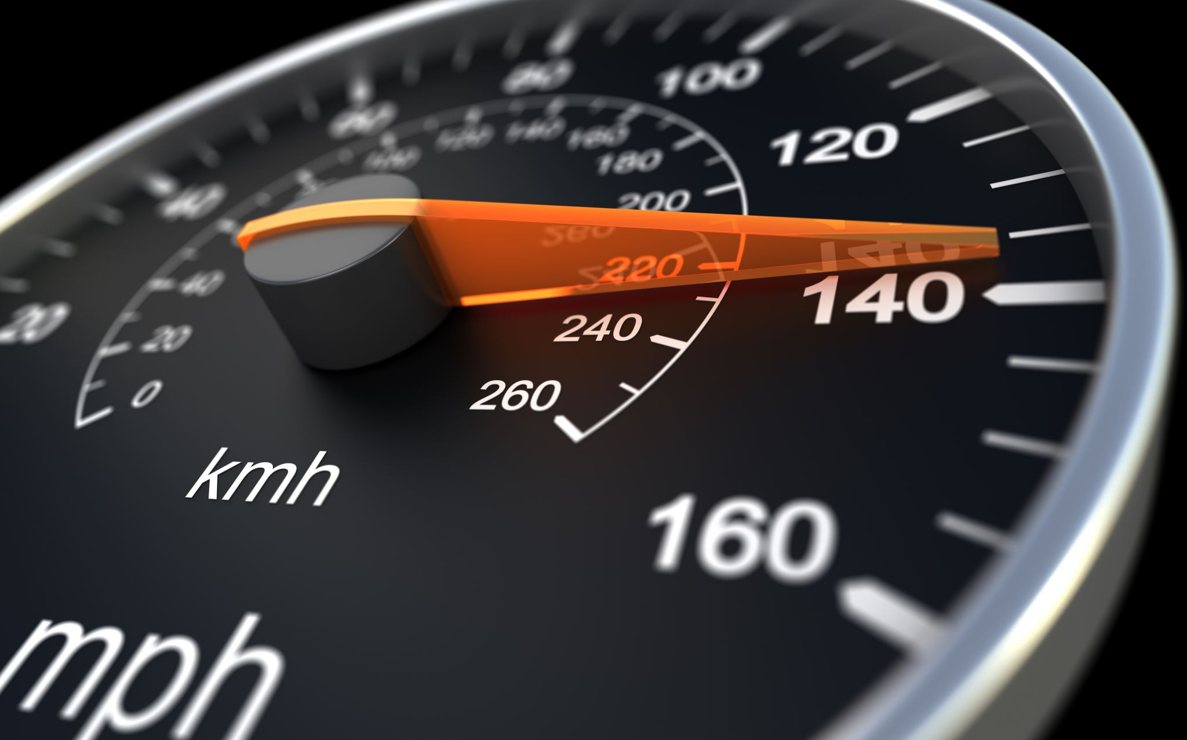
Motor vehicle crash info Texas 2013
Sony martin

Slide 2
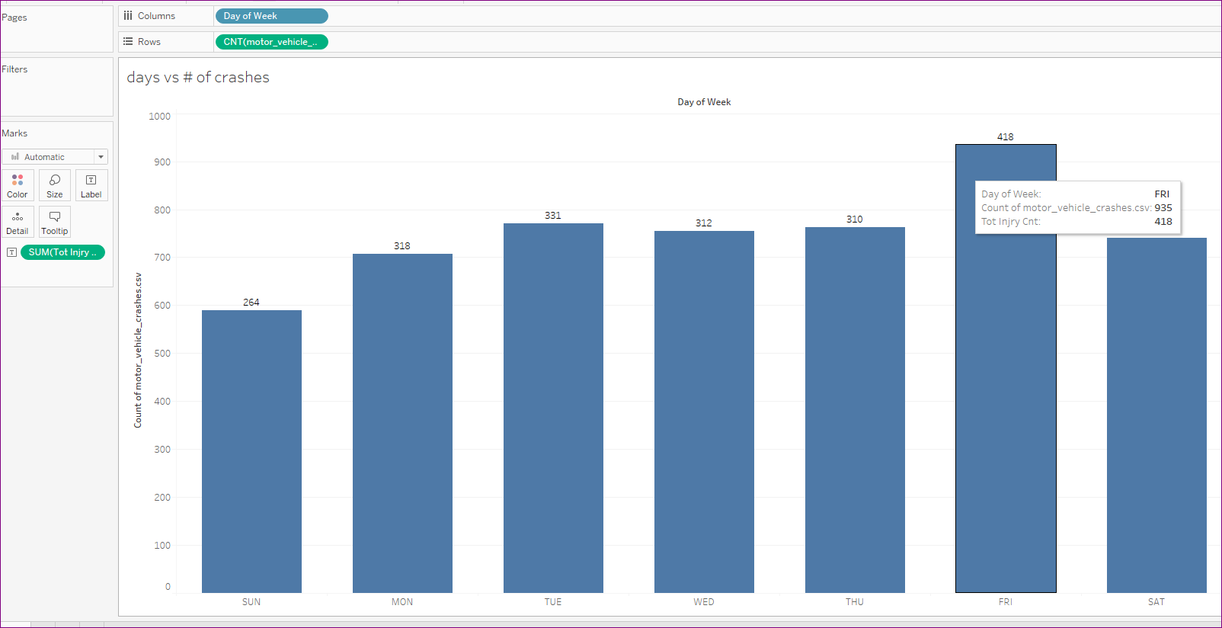
When do we hurry the most?

Slide 3
When do we hurry the most?
What days of the week have more crashes than others? From above the winner or loser is Friday. By the end of the week people are ready to get their weekend time off. In 2013 there were more crashes on Friday, with Saturday being the second highest. And for each day, almost half of the total accidents ended in injury.

Slide 4
Crashes by county
Texas is very large, in area, and population, so the population of the different counties is not proportionate to one another, Some counties had a significant amount of crashes compared to others. County 015 is for Bexar county, which houses the city of San Antonio so tourism is very high. In 2013 they had 497 crashes resulting in 227 injuries. County 82 which is Frio county has has 7 cities, had 1 crash, resulting in 1 injury. On of the next highest counties is county 57 which is Dallas county, had 463 crashes resulting in 270 injuries. The more populated a county the number of crashes increases.

Slide 5
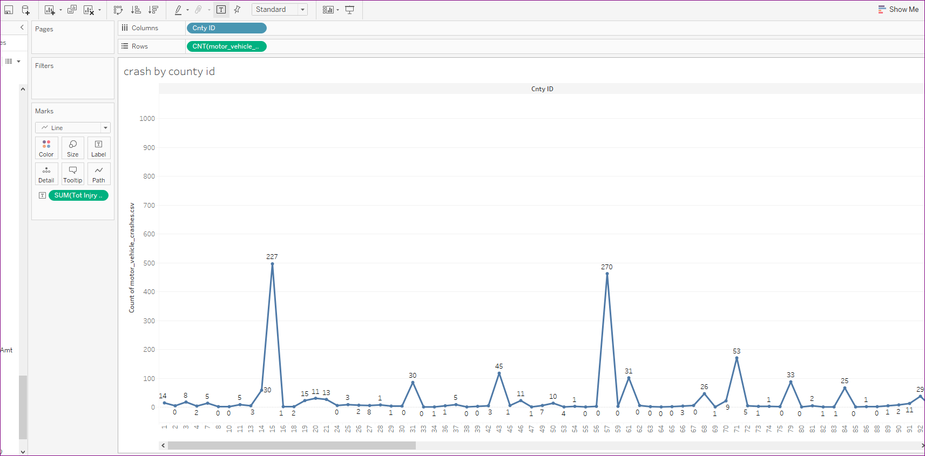
Crashes by county

Slide 6
Death toll by weekday
Despite having a higher speed limit in 2013 there were no fatalities on the toll roads.
There were equal amounts of fatalaties on Monday ,Friday and Saturday with a high of 8.
Thursday there was one.

Slide 7
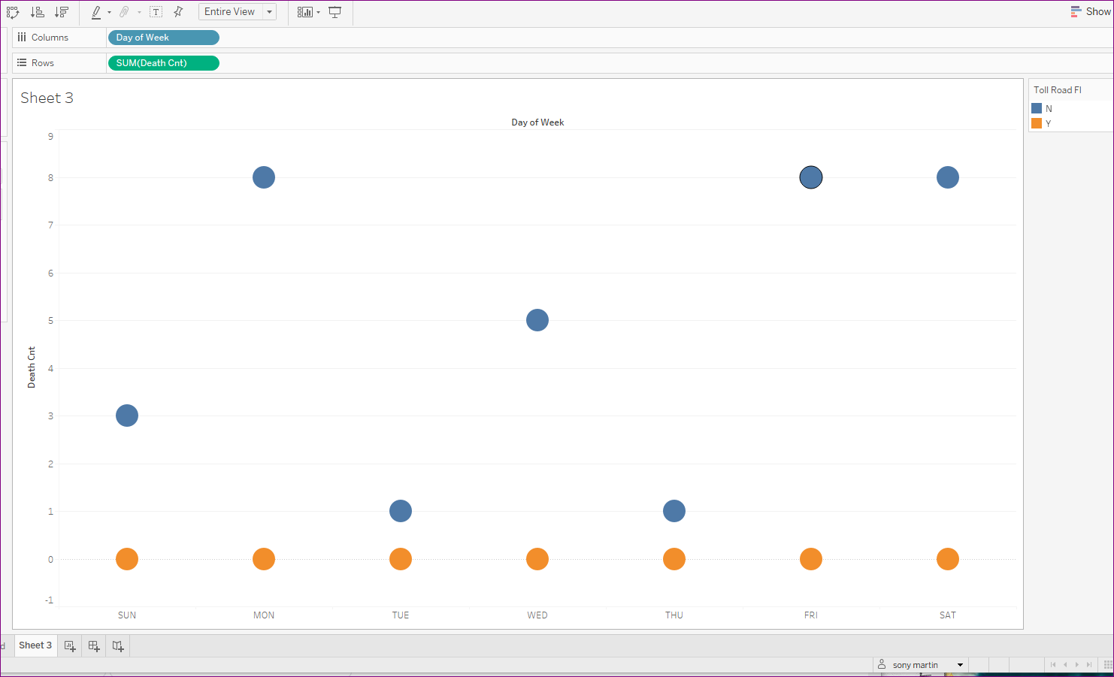
Death toll by weekday

Slide 8
Crashes by the month
Warm vacation months had a higher number of crashes than the colder months. Summer time more people on the road, more crashes. June and November had an equal amount of crashes, followed by March. March in Texas is spring break more drivers on the road. The lowest crashes was in the month of February. However, that being said there were 127 crashes. Keep in mind that it is also a shorter month with fewer days than the rest of the months of the year, it was still only slightyly less than the month of December, which had 165 crashes.

Slide 9
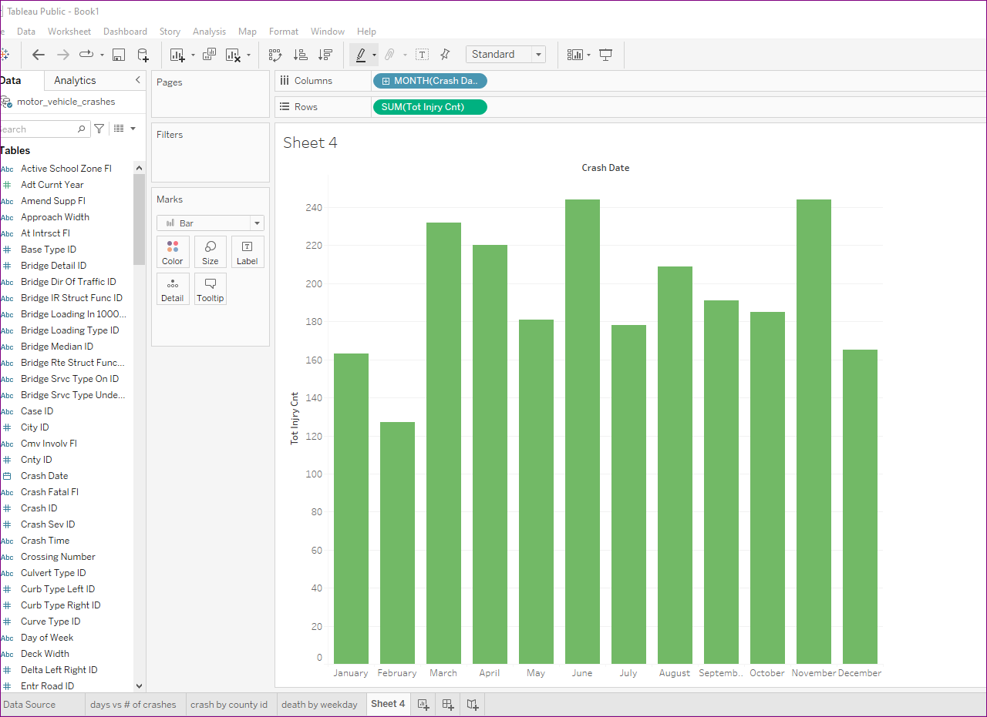
Crashes by the month

